Slide 1
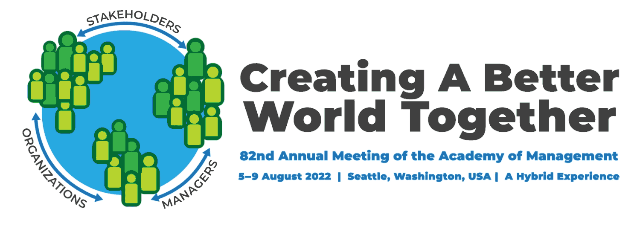

Re-thinking White Standards of Leadership to Develop Women, Black, South- and East-Asian Leaders
Presented by:
Soo Min Toh,* University of Toronto
Devyani Mahajan, Kansas State University
Phani* Radhakrishnan, University of Toronto
Jaffa Romain, University of Toronto
* Organizers
Pankaj Aggarwal, University of Toronto
Ahreum Maeng, University of Kansas
Alecia Bracy, Capella University
Pooja Khatija, Case Western University

Slide 2
Presenters
Talk 1: South Asian and East Asian CEO Media Narratives: A look at the Intersectionality of Race and Gender
Pooja Khatija
Talk 2: Facial Cues or Racial Hues? The Role of Face Ratio and Racial Bias in Perception of Leadership
Pankaj Aggarwal
Ahreum Maeng
Talk 3: African American Experiences of Unfairness in the Corporate Work Environment
Alecia Bracy
Talk 4: Conforming Yet Countering: Navigating Gender and Racial Stereotypes While Becoming a Leader
Phani Radhakrishnan
Jaffa Romain
Notes:
Randye – run down of typical procedures that we primarily support DIGs with – perhaps calling out some of the Treasurers on the call with examples for context
Reminder of current non-in person office reality with electronic payments only (good example of needing to adapt to our changing realities as Lucy raised just before)

Slide 3
Antecedents
Organizational
Stressors
Societal Member Characteristics
Racial harassment
Microaggressions
Slurs
Name-calling
Exclusion
Cultural bias
Socialization Factors
Stereotypes
Prejudicial Attitudes
Prototypes of racism
Media
Culture
History
Talk 3
Racial Discrimination
Performance Evaluations
Leadership Ratings
Talk 2
Talk 1
Talk 4

Slide 4

Conforming yet Countering: Navigating Gender and Racial Stereotypes While Becoming a Leader
Phani Radhakrishnan & Jaffa Romain

Slide 5
First Level
Second Level
Third Level
Fourth Level
Fifth Level

